Slide 1

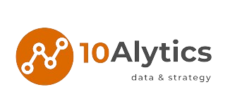

APACHE AIRFLOW
by Dr Ughele E.N
Orchestrating & Scheduling Workflows

Slide 2
Learning objectives
By the end of this session, you should:
● understand what data pipelines really are;
● know what the differences between directed acyclic graphs and cyclic graphs are;
● be able to represent data pipelines in a graphical format;
● understand the core architectural components of Airflow; and
● know the process of using Python to define a DAG.

Slide 3




Airflow Introduction
Alte
Alternatives
Alte
Apache Airflow is an
open-source platform to
programmatically author,
schedule, and monitor
workflows.

Slide 4


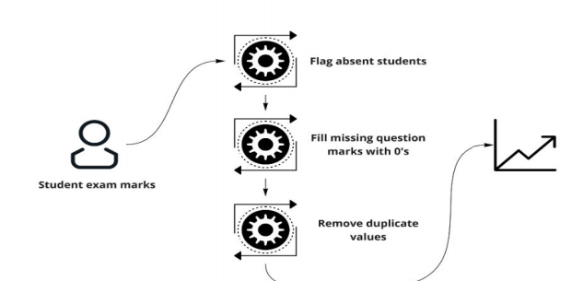
Source | Transformations | Destination
A workflow is a sequence of tasks
In airflow, this sequence is defined by DAG
Database

Slide 5

The
Objective:
Data Transformations:
Design a data pipeline for processing student and making it ready for further analysis and insights by data consumers.
Data Transformations:
Absent Students
Metrics:
Class Average
Best Performing Student
Lowest and Highest Scoring Questions
Erroneous Data Entries
Wrong formatting

Slide 6
Process
Overview
Extract data from the dataset
Apply data cleaning transformations
2
Aggregate data & make it ready for Data consumers
1
3
Clear Insight into students performance
Enables quick decisions-making for educators and administrators.
Identifies areas for improvement and enhances overall academic performance
BENEFITS:

Slide 7
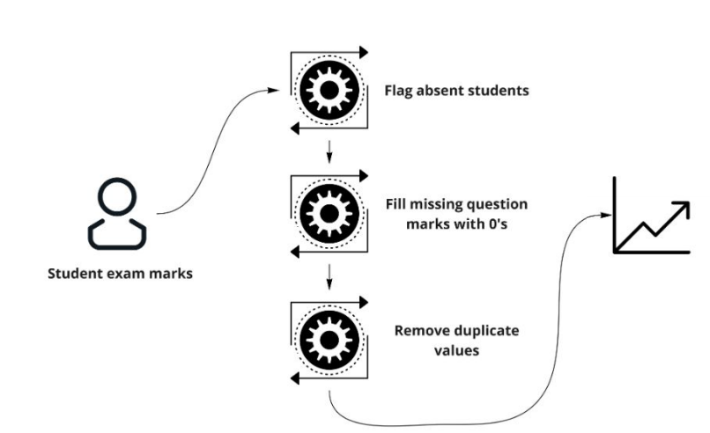
Directed Acyclic Graph(DAG) is a graph structure consisting of nodes (tasks) and edges (dependencies) where each edge indicates that one task must be executed before another. Directed means the edges have a specific direction, and Acyclic means there are no cycles or loops in the graph.
Database

Slide 8






Benefits of DAGs
Each node in the graph typically represent an individual task or operation, allowing for modular design and easier maintenance
DAGs offer a clear visualization of the
pipeline's structure and data flow, making it easier to understand complex data processes
ERROR
HANDLING
MODULARITY
PARALLELISM
VISUAL CLARITY
Visualizing the pipeline as a graph allows better error tracking and management, enabling faster debugging and troubleshooting
DAGs enable identifying parallel processing opportunities, optimizing performance, and reducing latency

Slide 9

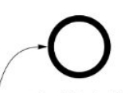
A task represents a unit of work or astep in the workflow. It can be anything from running a Python script, executing a SQL query, transferring files , sending emails, etc. etc. Each task is a component
that performs a specific action.
Send data to database
The first task in the
pipeline is to fetch
the student marks data.
The last task in the
pipeline is to push the
transformed data to
the database.

Slide 10
Operator:
An operator is a class that defines what the task actually does.
Airflow provides a variety of built-in operators, such as:
Bash Operator for executing Bash commands,
Python Operator for executing Python functions,
SQL operators for running SQL queries, and more
Operators encapsulate the logic of a task.

Slide 11
The execution algorithm of a DAG
For each open (unexecuted) node in the DAG:
Identify the upstream task(s) upon which the current task is dependent.
Determine if all upstream tasks identified have been successfully executed.
If all upstream tasks identified have not been successfully executed, move to the previous task and repeat steps a) and b).
If all dependent tasks have been successfully executed, add the current task to a queue of tasks to be executed.
Sequentially execute the tasks in the queue:
Assign a "completed" status to the tasks that have been successfully executed.
Repeat steps 1) and 2) for the remaining tasks in the DAG

Slide 12
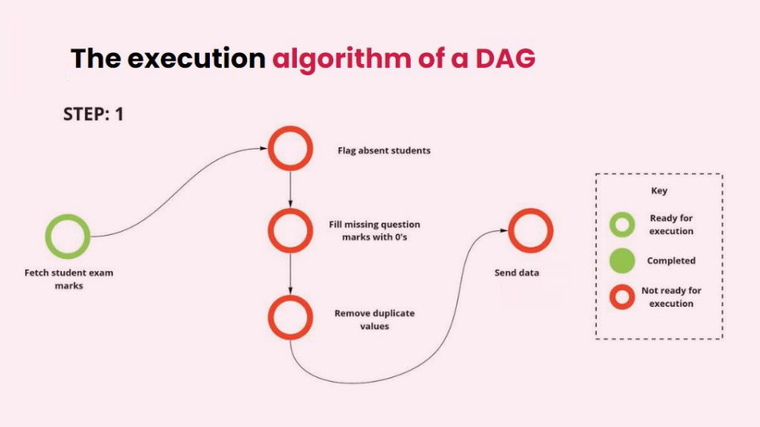

Slide 13
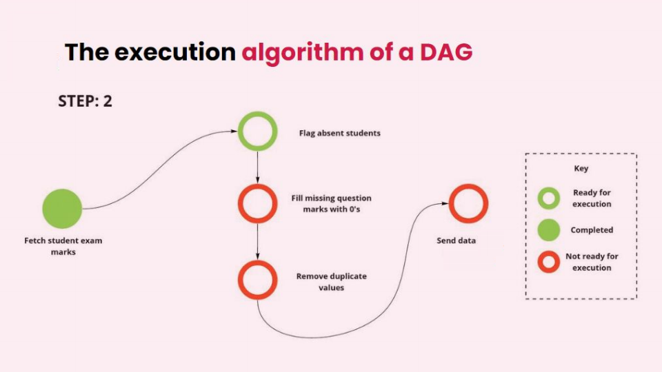

Slide 14
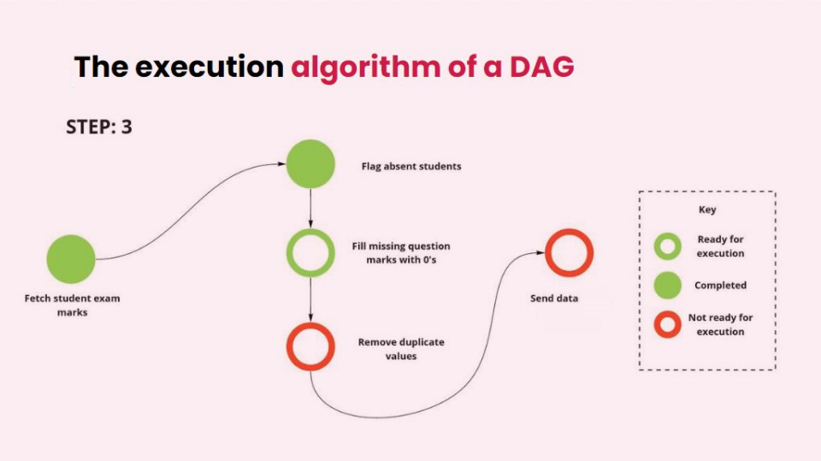

Slide 15
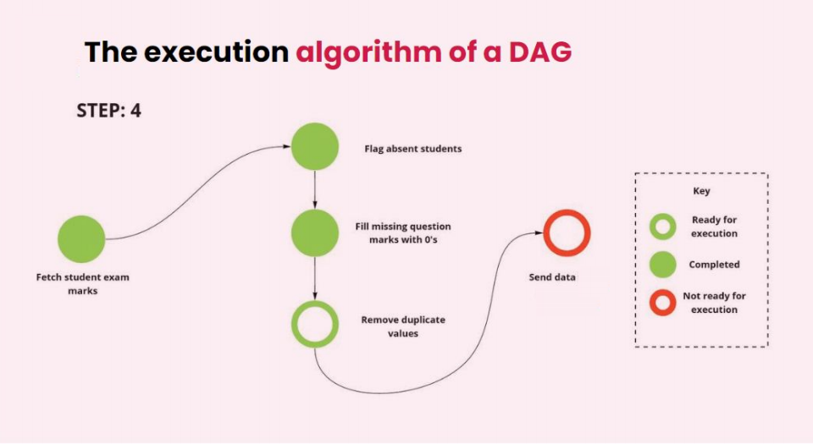

Slide 16
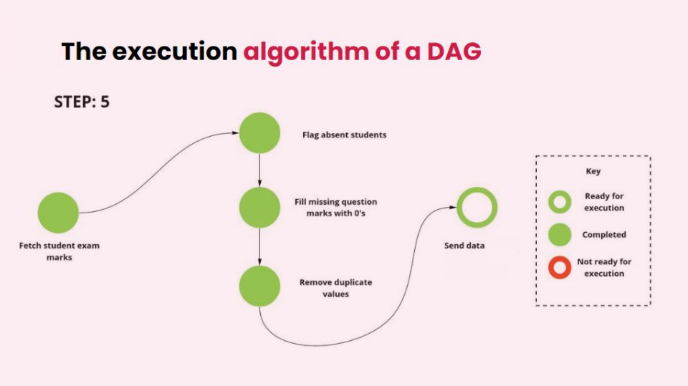

Slide 17
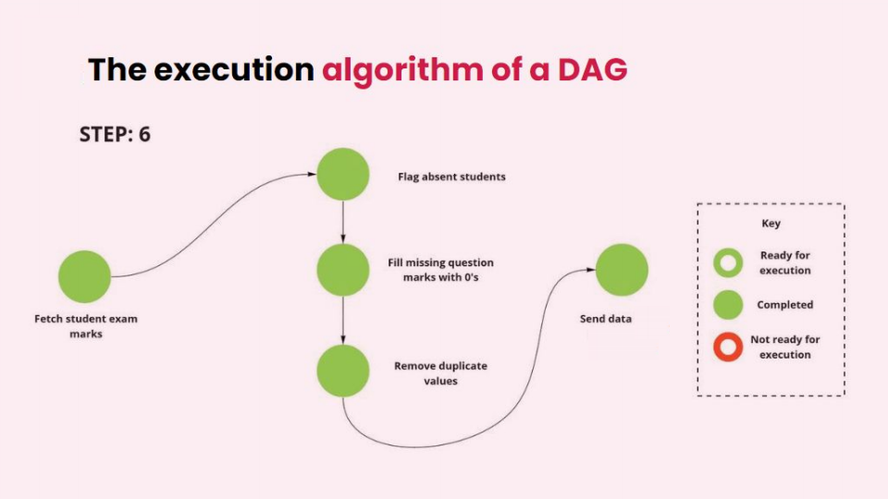

Slide 18
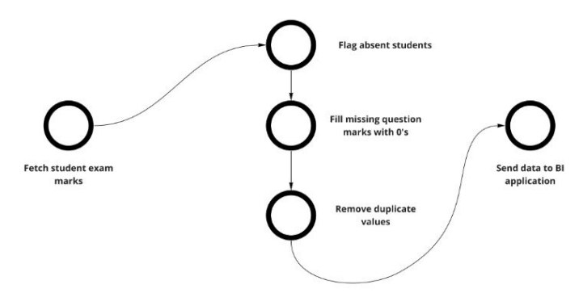
Representing our example data pipeline as a graph
The first task in the pipeline is to fetch the student marks data.
Similarly, the last task in the pipeline is to push the transformed data to the BI application.
The direction of the edges indicates the direction of task dependency within the pipeline. For example, the arrow pointing from the "Flag absent students" node to the "Fill missing question marks with zeroes“ node indicates that the flagging operation executes before the filling one.
This type of graph, where there is directional dependence, is referred to as a directed graph. When such a graph contains no loops or cycles (no node has a dependence on nodes further down the chain of execution), it is known as a directed acyclic graph (DAG). To illustrate this point, we can observe in our example graph how task dependence flows from the “Fetch student exam marks" node all the way to the "Send data to BI application" node, without ever referring to a previous task. As such, our example pipeline graph is a DAG.

Slide 19
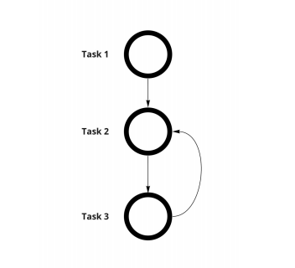
A Simple Cyclic Graph Representing A Malformed Pipeline
Task 2's dependence on Task 3 means that it can never successfully execute, leaving the pipeline in a deadlock.
Let's imagine for a brief moment that there was no requirement for a pipeline, represented by a graph, to be acyclic. How would this affect the pipeline's execution? Figure 4 can help us reason this out. Here we can see directed connections from Task 1 to Task 2, and then to Task 3. However, we also see that Task 3 links back to its previous task. Following this chain of dependence, once Task 1 completes, we expect Task 2 to begin. However, Task 2 can't begin as it awaits output from Task 3, which will never occur as Task 3 needs the output from Task 2. Such a scenario leads to a flaw in our simple example's execution logic, and hence, a pipeline with a cyclic dependence will never execute, as it will remain in a deadlock state.

Slide 20
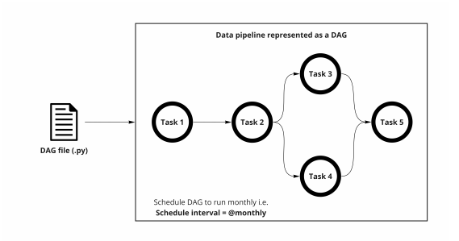
Defining a DAG as a python script

Slide 21
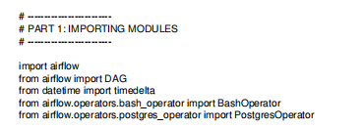
Defining a DAG as a python script
Part 1: Importing modules

Slide 22
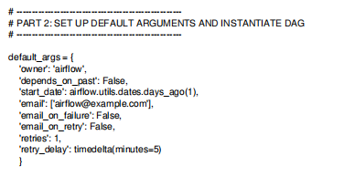

Defining a DAG as a python script
Part 2: Default arguments and DAG instantiation

Slide 23
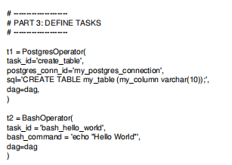
Defining a DAG as a python script
Part 3: Task definitions

Slide 24
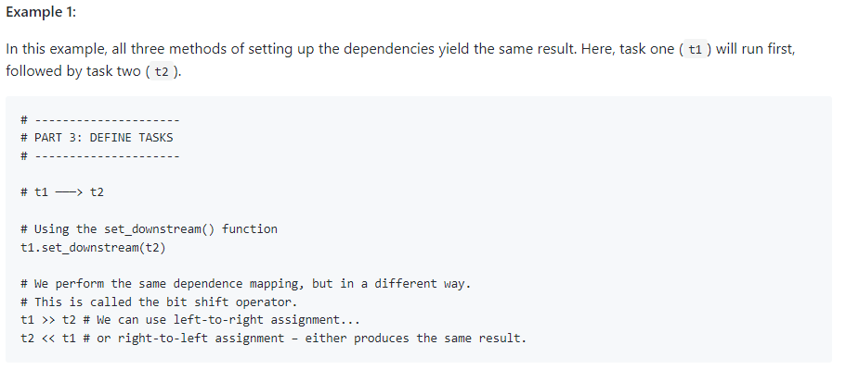
Defining a DAG as a python script
Part 4: Setting up task dependencies

Slide 25
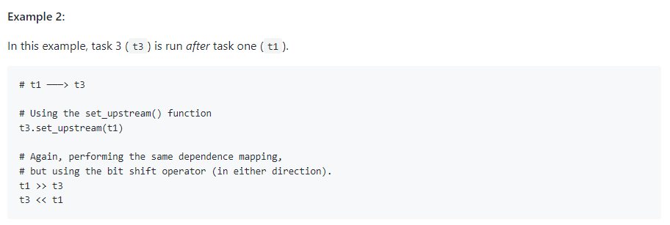
Defining a DAG as a python script
Part 4: Setting up task dependencies

Slide 26
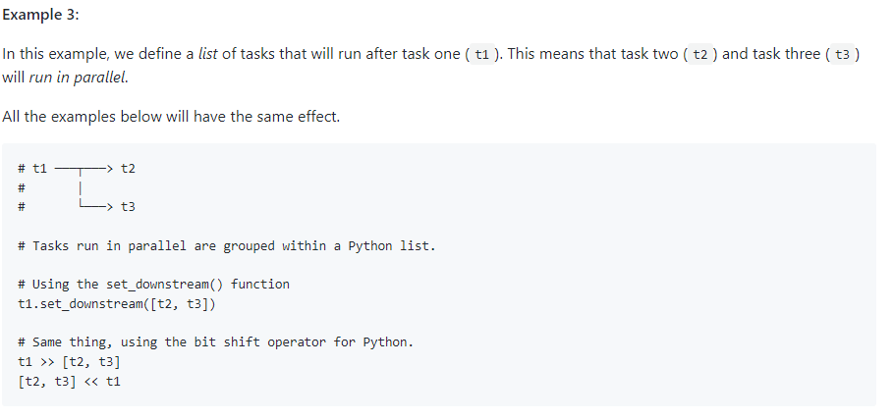
Defining a DAG as a python script
Part 4: Setting up task dependencies

Slide 27
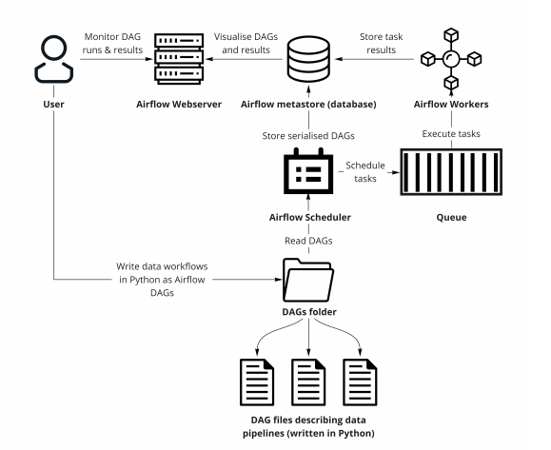
A Typical Airflow Session

Slide 28
CASE STUDY FOR ZIPCO FOODS

Slide 29
Executive Summary for Zipco Foods
Zipco Foods is a vibrant and growing business that specializes in the sales of pizzas and cakes. As a key player in the fast-casual dining industry, Zipco Foods operates numerous outlets across the country, serving a wide variety of pizzas and cakes that cater to local tastes and preferences. With a strong commitment to customer satisfaction and quality service, Zipco Foods aims to leverage advanced data engineering solutions to enhance operational efficiency, improve product offerings, and ultimately boost profitability.

Slide 30
Business Problem Statement
Zipco Foods generates a significant amount of sales data daily, which is currently underutilized due to inefficient data handling and analysis processes. The primary challenge is the disparate nature of data collection and storage, with critical sales and inventory information scattered across multiple CSV files without a unified system for aggregation and analysis. This fragmentation leads to operational inefficiencies, including delays in data access, difficulty in obtaining real-time insights, and challenges in maintaining data integrity and accuracy.

Slide 31
Objectives & Benefits
Objectives:
Implement a streamlined ETL (Extract, Transform, Load) pipeline to automate data processing and ensure data consistency.
Design a database schema that supports efficient data retrieval and scalability while adhering to 2NF/3NF normalization standards.
Develop a system for real-time data analytics to aid in decision-making processes.
Ensure robust data governance and compliance through effective version control and data orchestration.
Benefits:
Enhanced decision-making capabilities through real-time, accurate data analytics.
Improved operational efficiency and reduced manual labor by automating data processes.
Greater scalability and flexibility in data management, accommodating future business growth.
Strengthened data integrity and reliability, ensuring high-quality information for strategic planning.

Slide 32
Tech Stack
Python: Utilized for scripting the ETL processes, data cleaning, transformation, and analysis tasks due to its powerful libraries like pandas and NumPy.
SQL: Employed for querying, updating, and managing the database stored in Azure, ensuring efficient data manipulation and retrieval.
Azure Blob Storage: Chosen for its scalability and reliability, serving as the centralized data repository for storing processed data.
Github: Used for version control, allowing for collaborative development and maintenance of the ETL scripts and other project documents.
Apache Airflow: Orchestrates the ETL processes, scheduling jobs efficiently and monitoring the workflow of data through various stages of the pipeline.

Slide 33
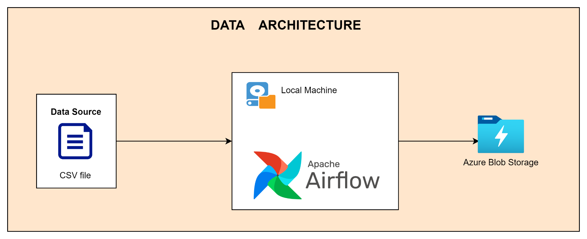
Data Architecture

Slide 34
Data Source
This is the link to the data source ⇒ LINK

Slide 35
Project Scope
Data Extraction
Extract data from various CSV files into a Pandas DataFrame. This step involves reading large datasets efficiently, handling different data formats, and managing incomplete or corrupt data files.
Data Transformation
Clean the extracted data to remove inconsistencies, duplicates, and handle missing values.
Transform the data to fit into a designed schema that adheres to the principles of 2NF and 3NF. This involves decomposing tables to reduce redundancy, ensuring referential integrity, and optimizing the schema for query performance.

Slide 36
Project Scope
Data Loading
Load the cleaned and transformed data into Azure Blob Storage, which serves as the centralized repository for all analytical data.
Implement version control using GitHub to maintain revisions of the data transformation scripts and other configurations.
Use Apache Airflow to orchestrate the entire ETL process. Define DAGs (Directed Acyclic Graphs) to manage the workflow of tasks including dependencies and sequence of operations, ensuring that the data flows smoothly from extraction through to loading, with logging and error handling to manage failures or retries effectively.
This case study outlines the strategic approach for utilizing advanced data engineering techniques to drive operational improvements and business growth for Zipco Foods.

